Slide 1

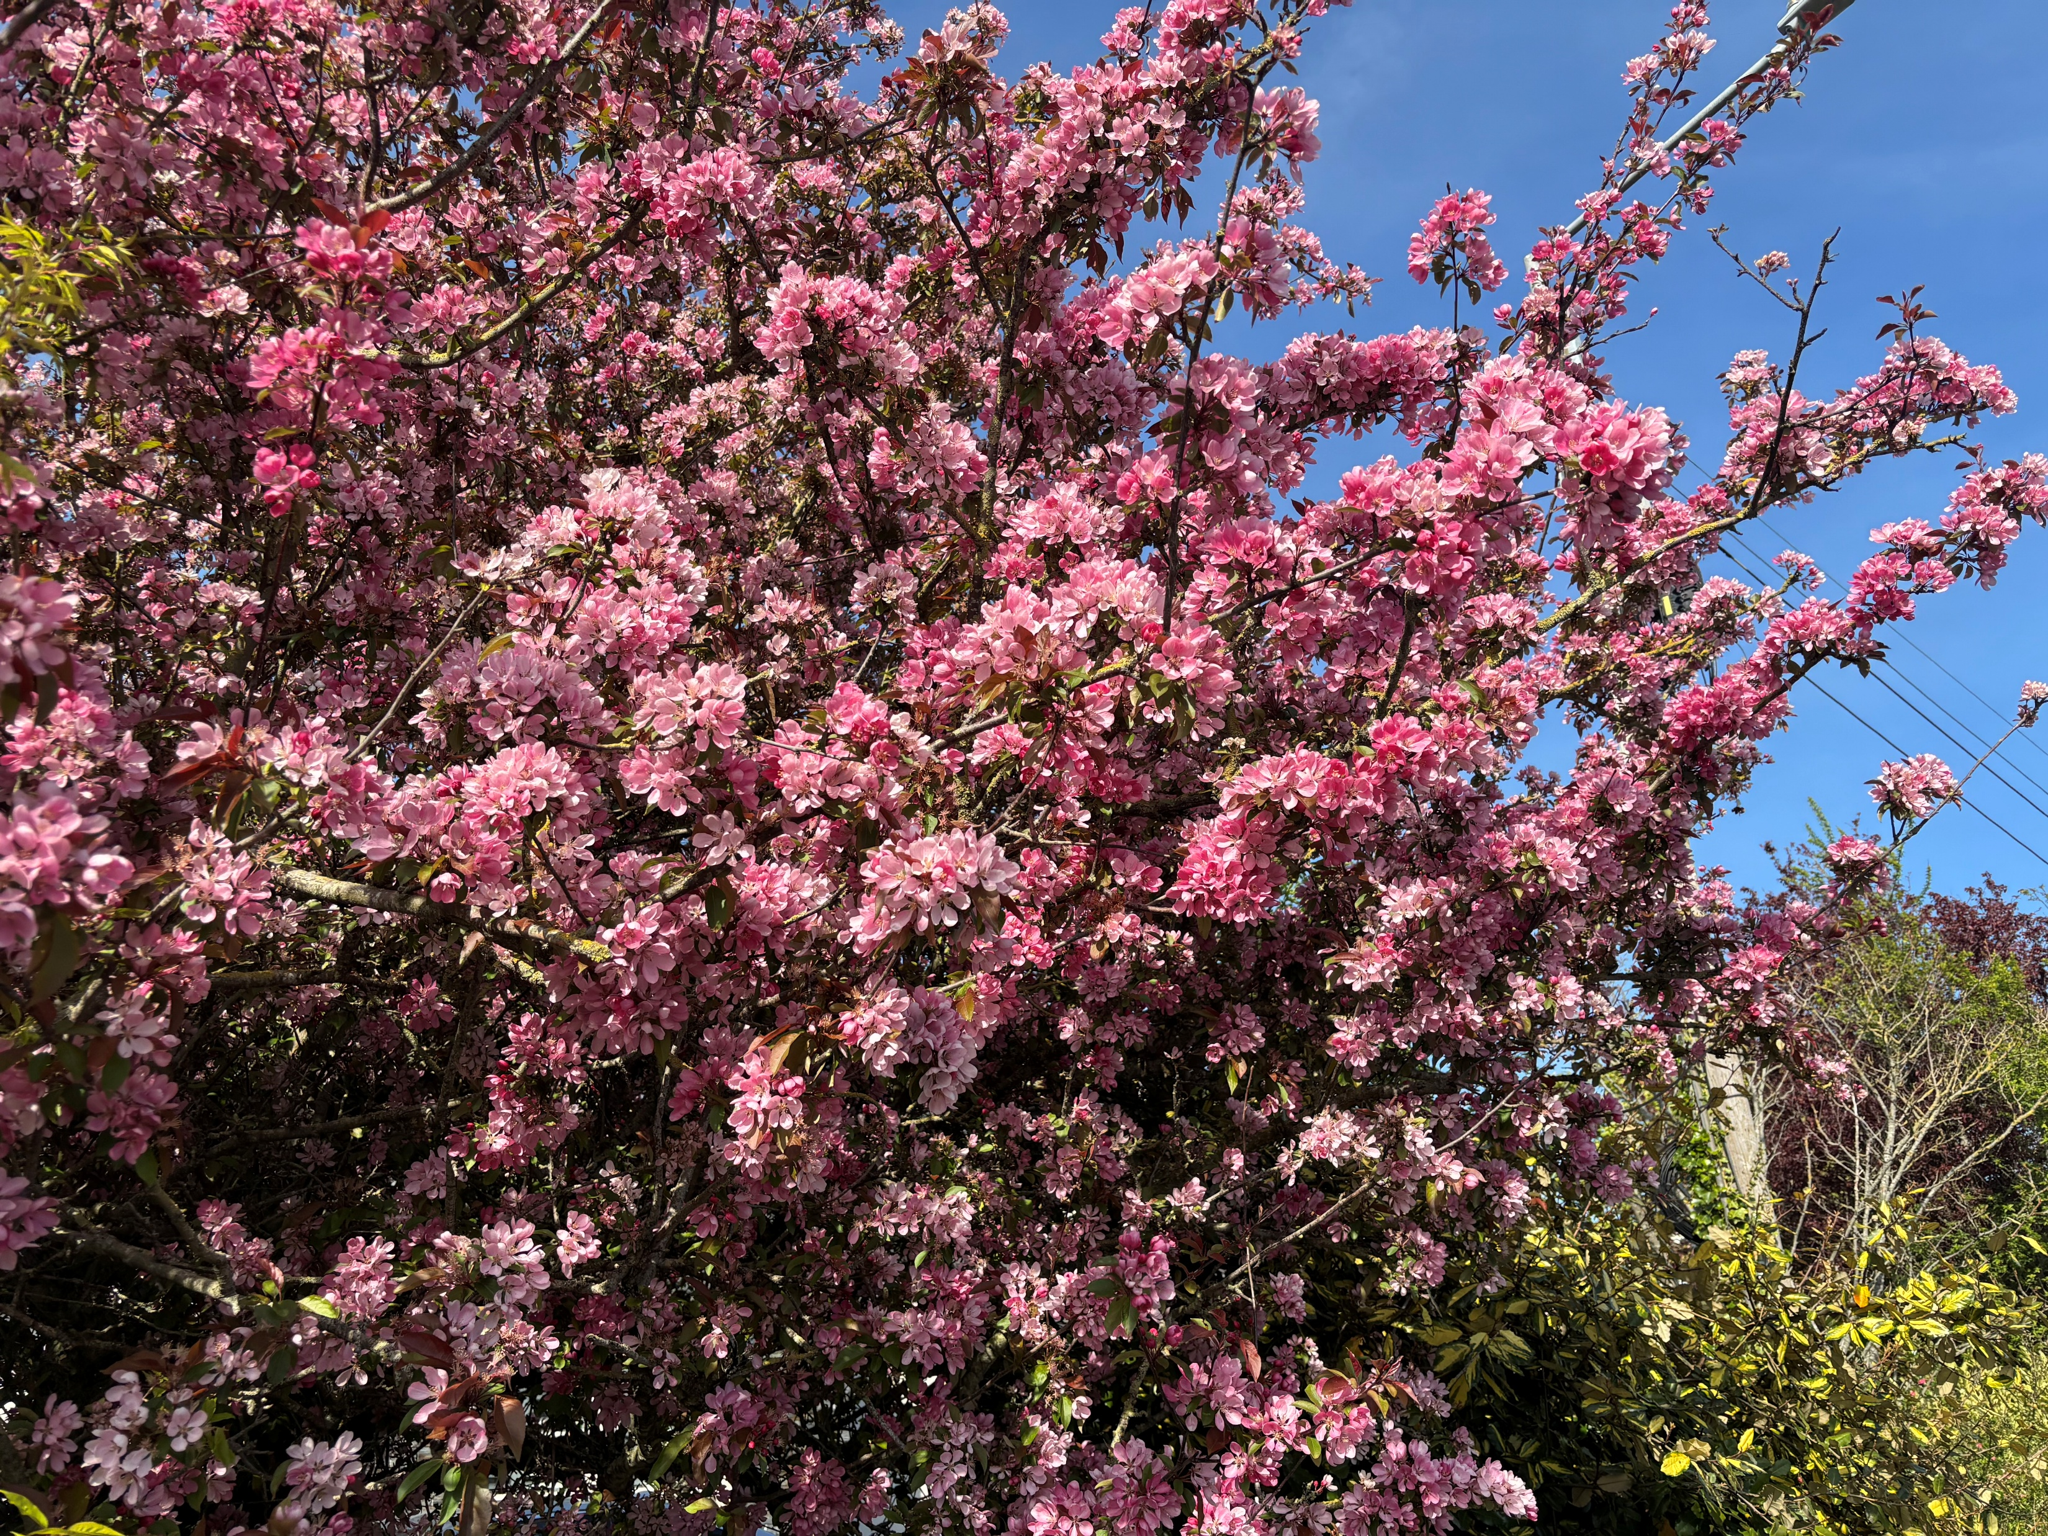
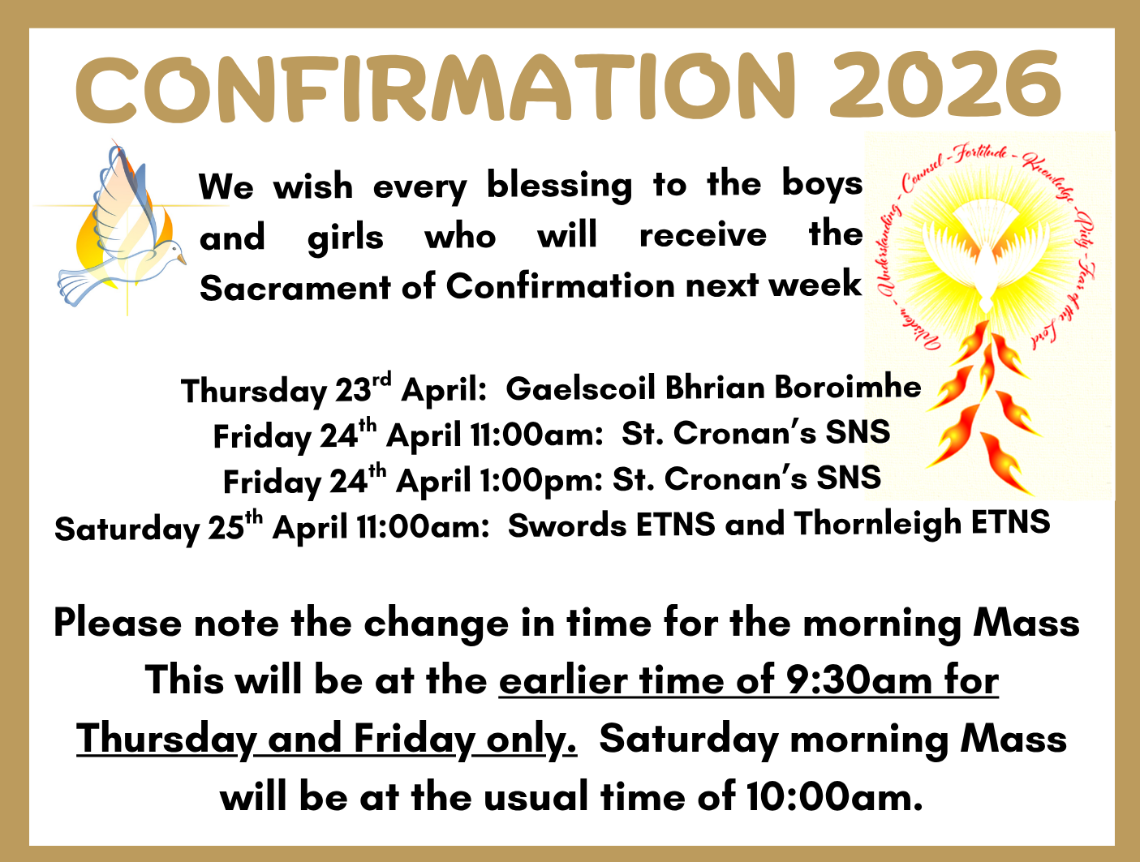
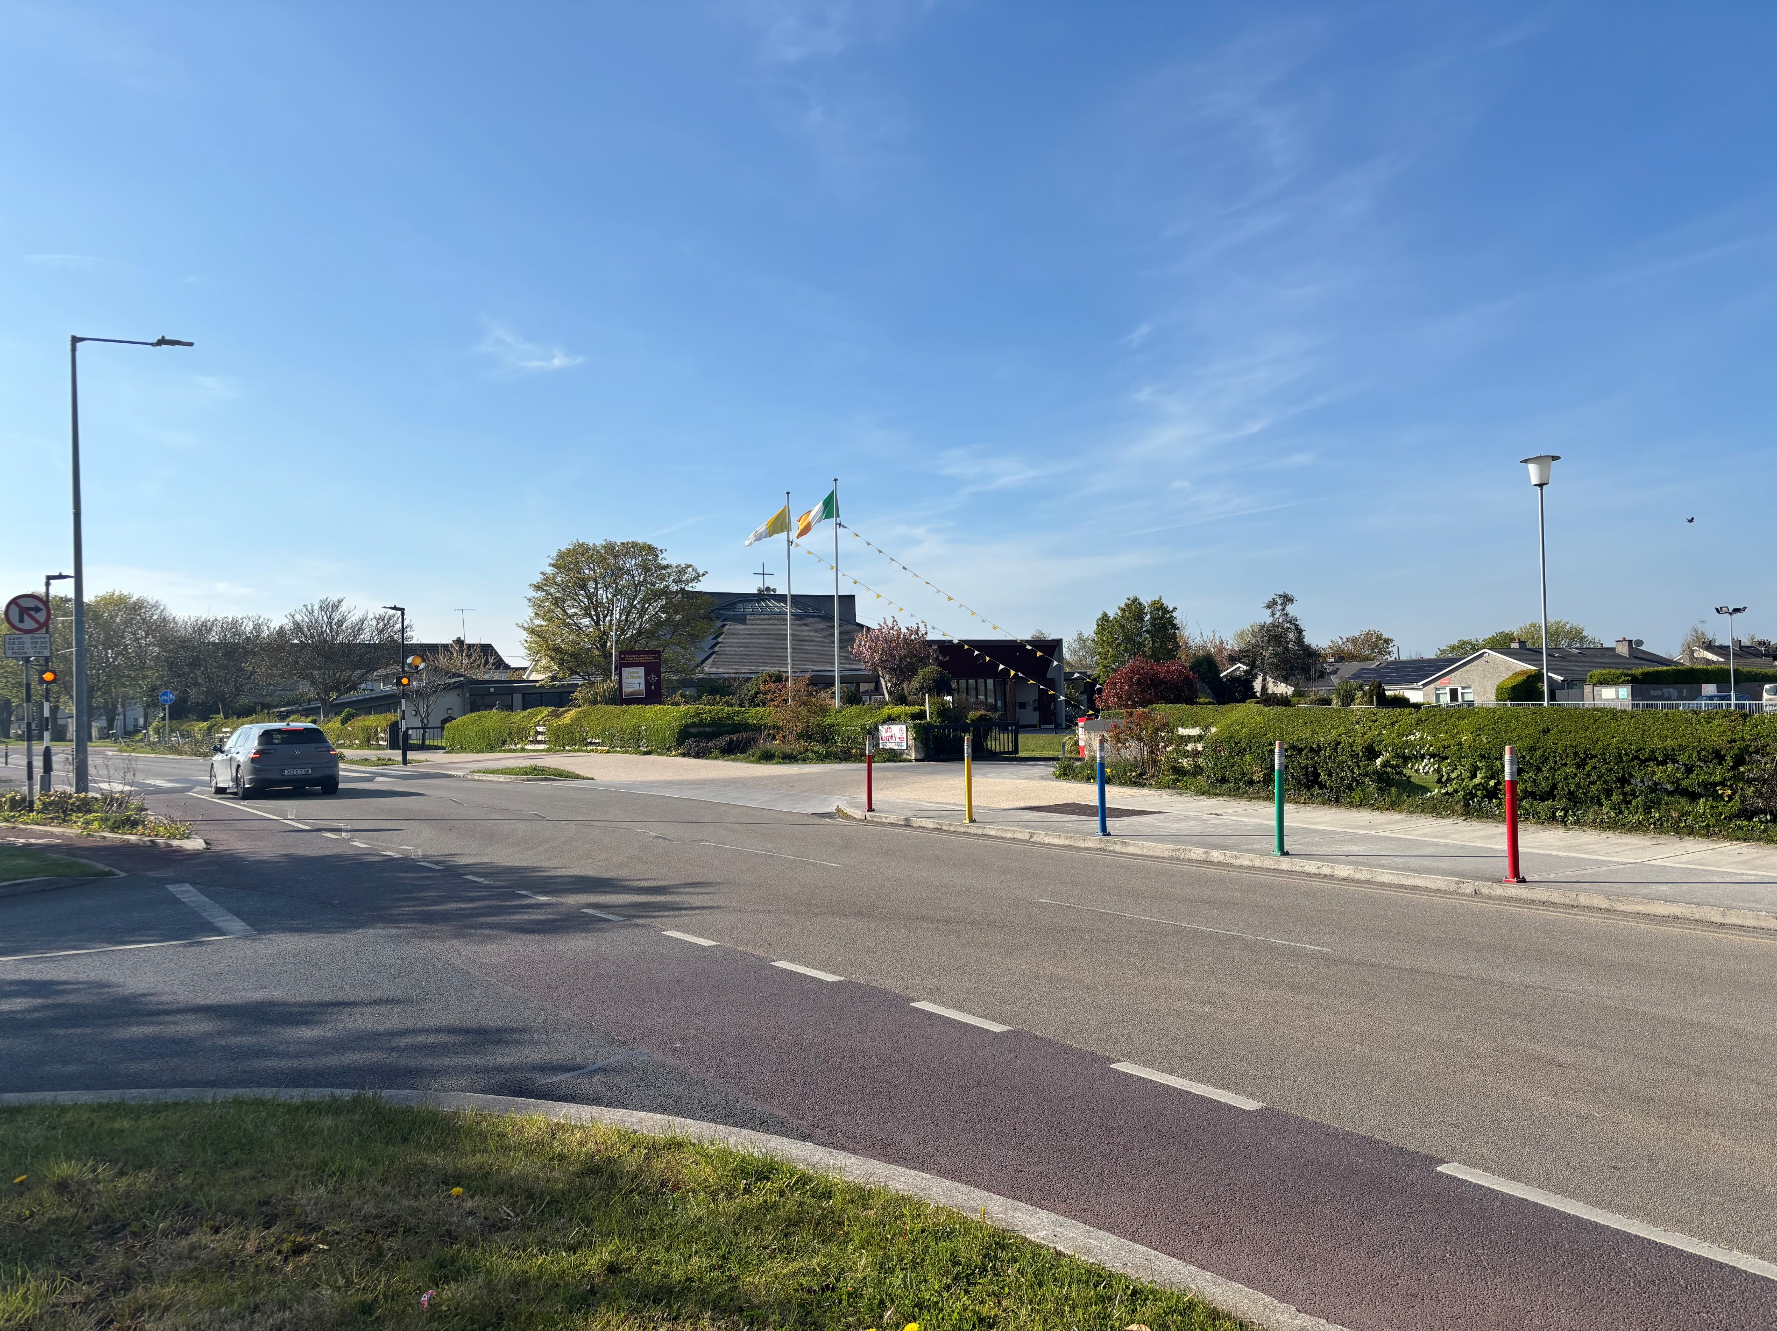
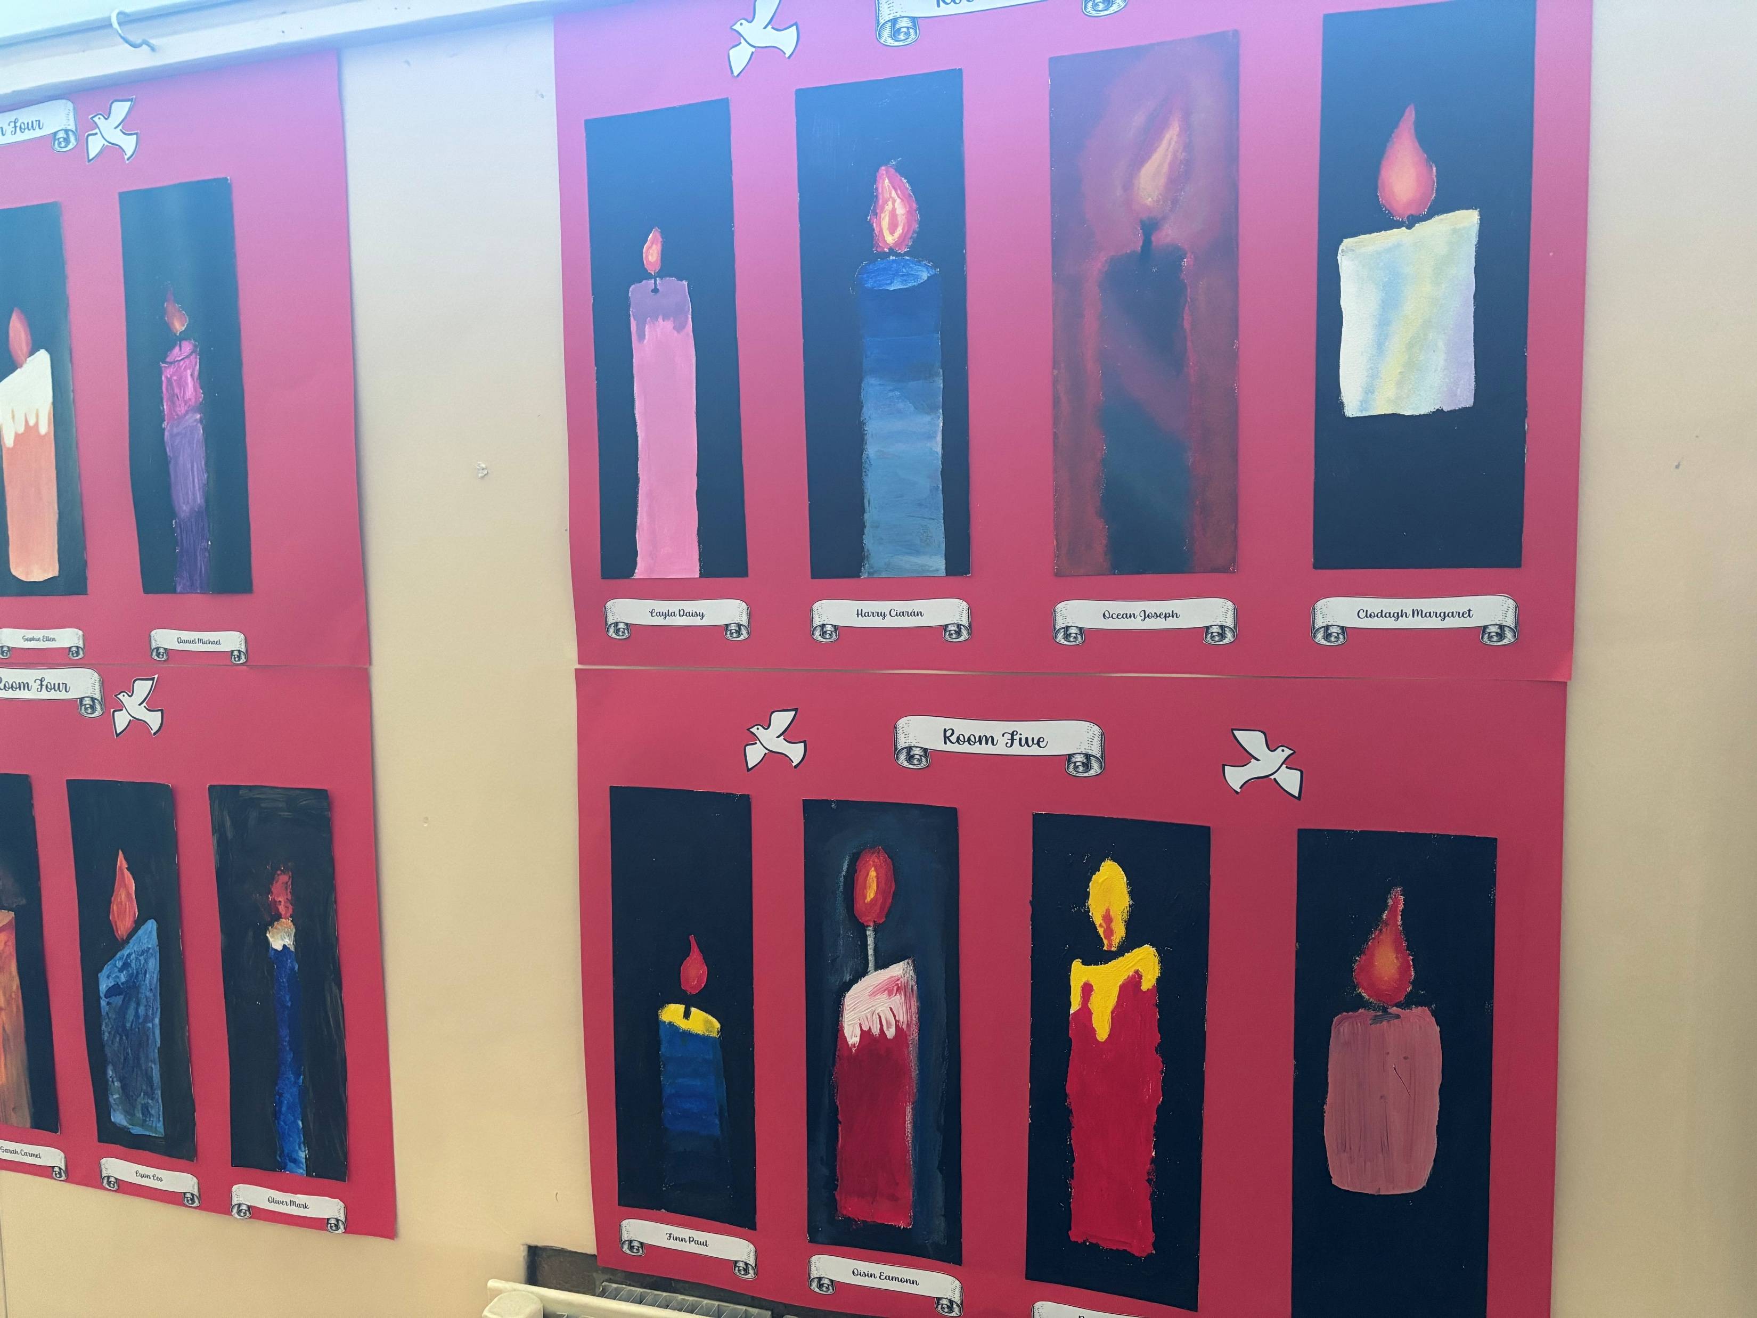
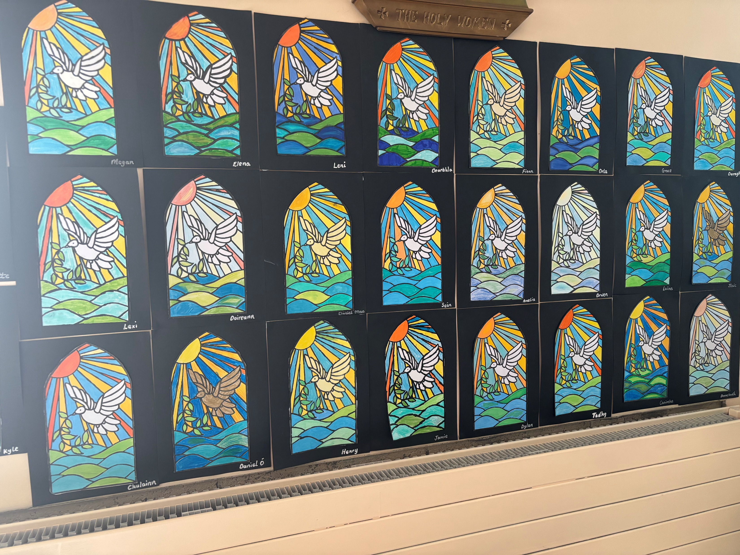
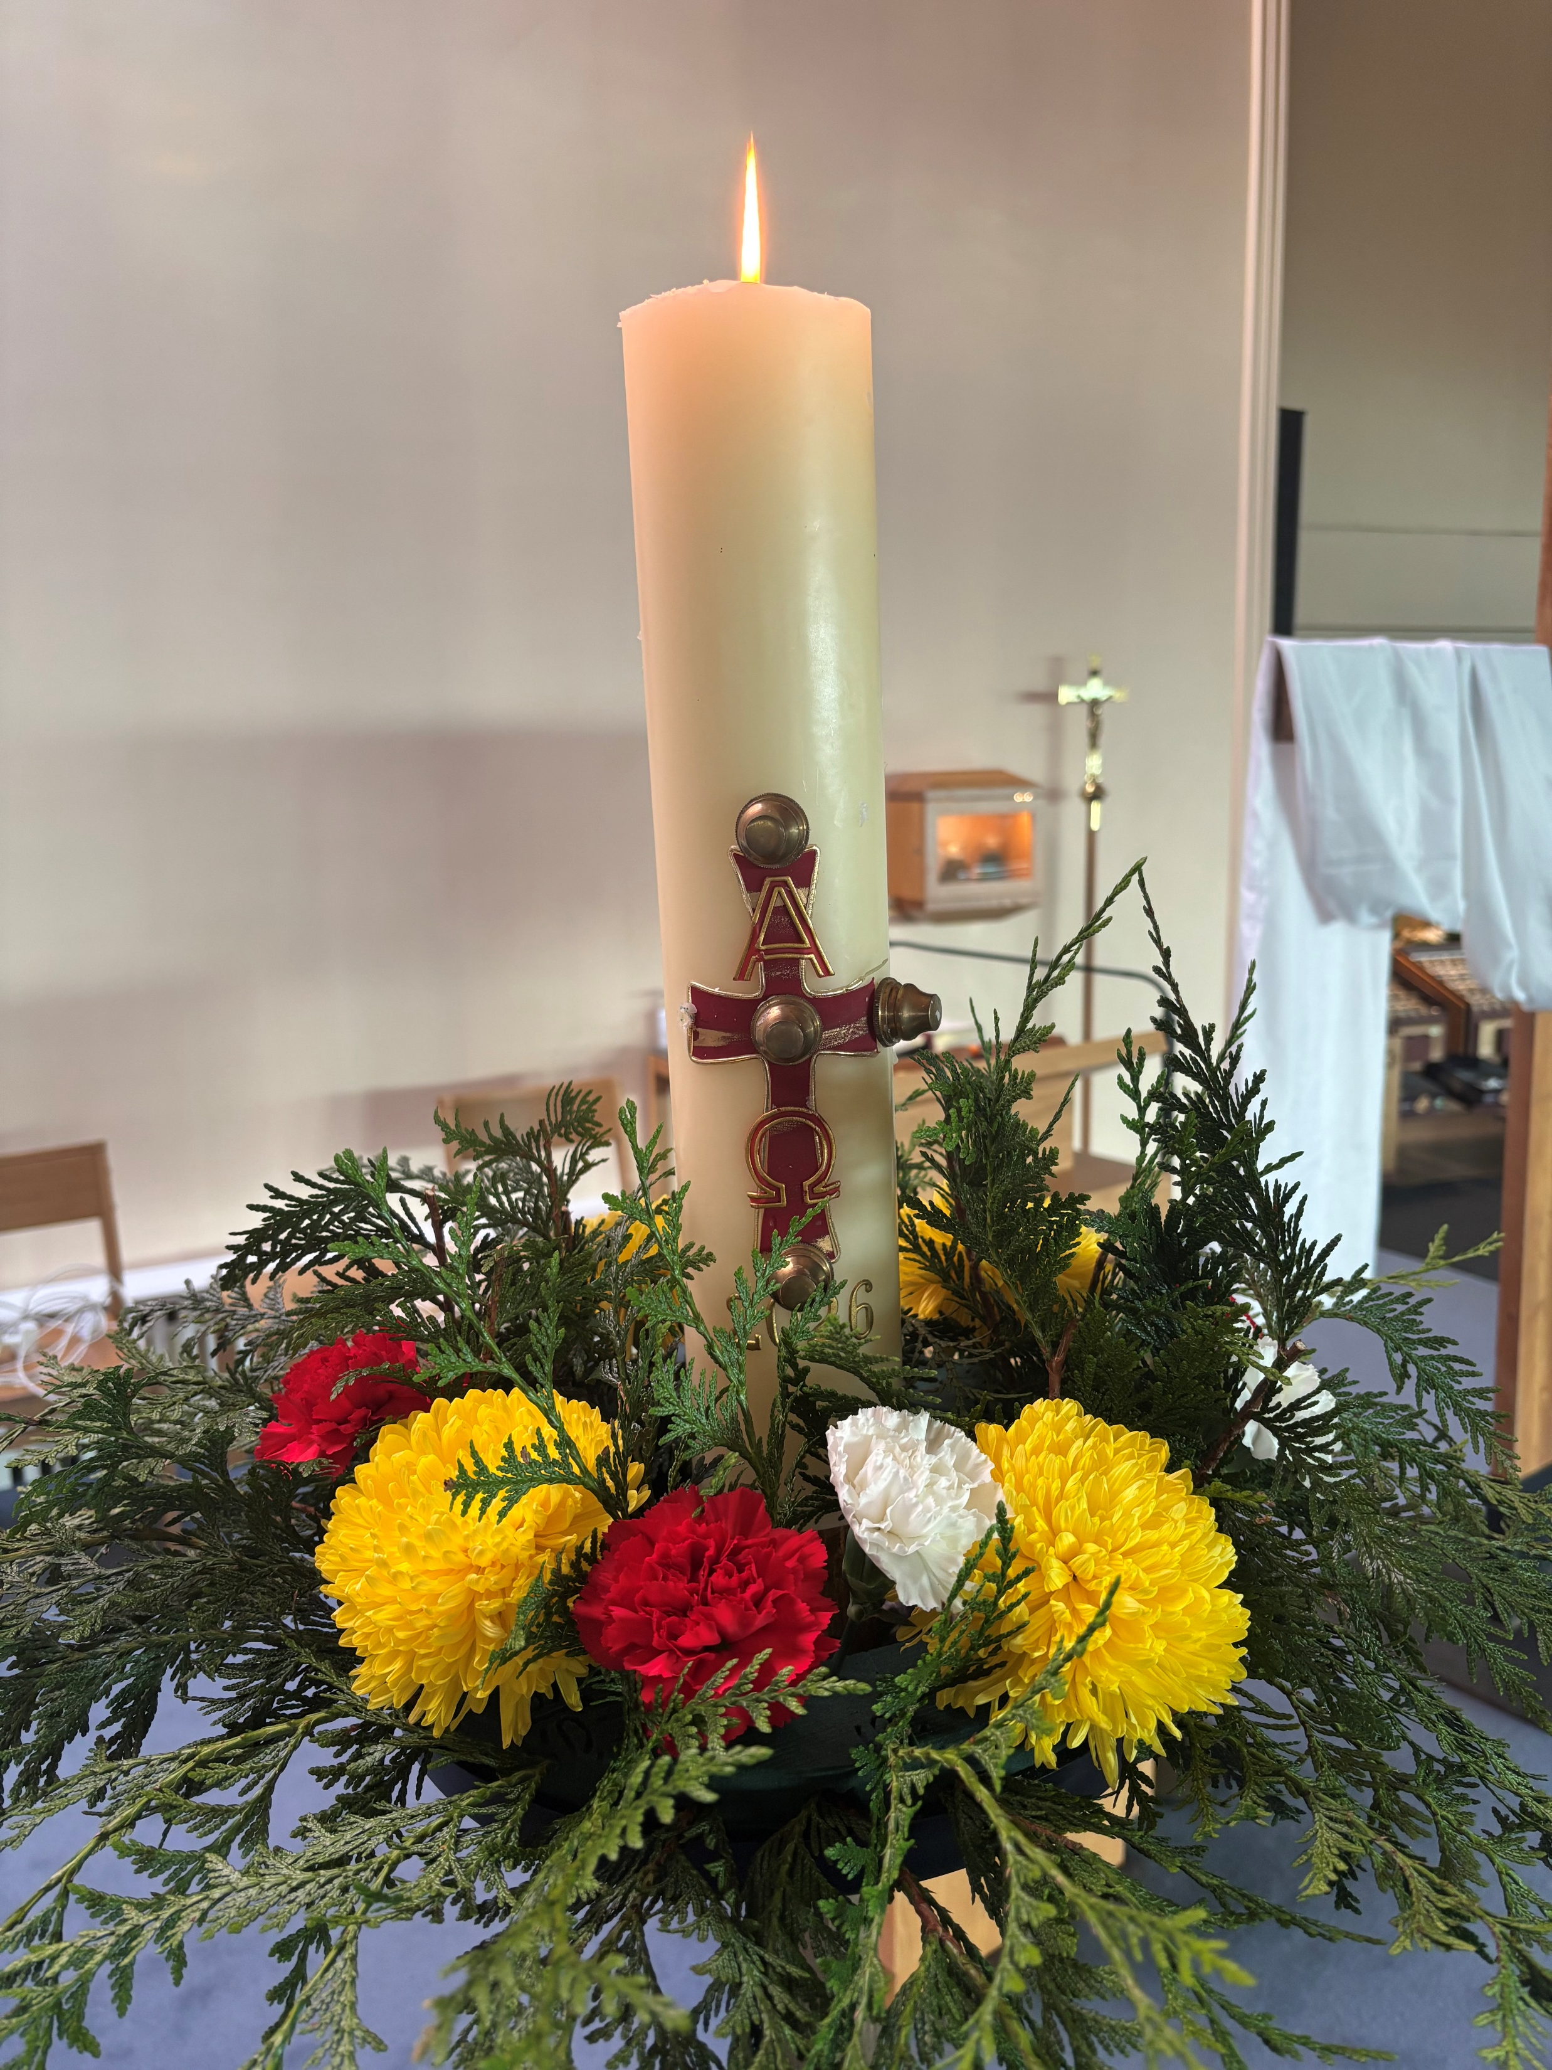
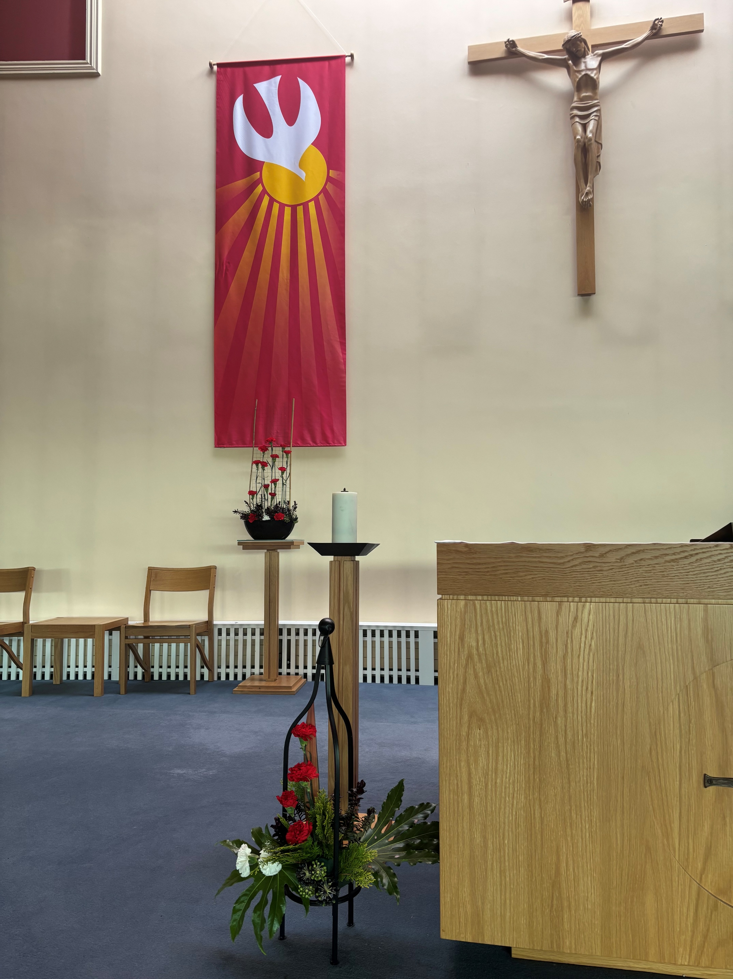
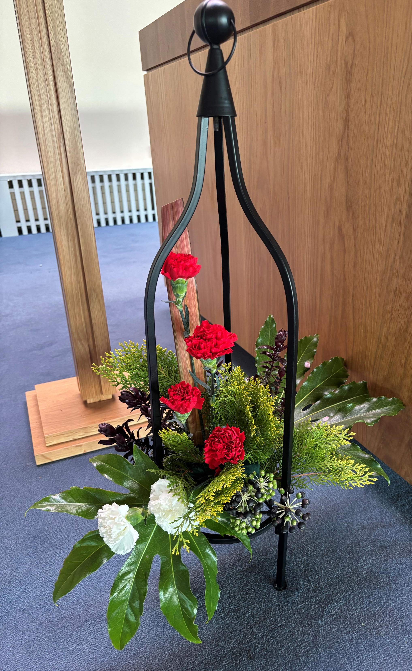
4TH SUNDAY OF EASTER 26 APRIL 2026 YEAR A
Becoming an Autism Friendly Parish
Sacraments are special moments in the life of a parish, where we welcome those who seek growth in faith and a deeper sense of belonging as a member of our faith community. In response to a significant cohort of the children who are preparing for sacraments presenting with additional needs, such as autism, the parish sacramental team is exploring how best we can accompany these children and their families.
Our church has always been a place of true Gospel welcome and inclusion. Every child with additional needs is a unique individual with a specific set of challenges. We want to ensure that families feel welcome and can relax in our church as they attend Mass and prepare for sacraments. As part of our Building Hope pastoral outreach, we have already begun a preparation programme working with children with additional needs and their families. This will ensure that the individual needs of a child and family are met so they can participate in sacramental preparation and become more fully integrated into our parish community.
Coming to Mass can cause a lot of overstimulation for some children with additional needs. Some need to find a way to relieve tension. This may include walking around in circles or patterns; they may talk to themselves, they are trying to process their environment. Sometimes they may hold a favourite toy or an object that helps them relax. You may see children wearing headphones to listen to soothing music, or to block out the noise of crowds which can upset them. Sometimes children with additional needs find it difficult to sit in one place and need to move around the church. It may be easy to assume that a child is acting up during Mass, when, in fact, he/she is over stimulated. It is helpful when we as a parish community show understanding and support for these families, especially for parents who may feel very self-conscious about their child’s behaviour in church.
‘Please try to understand me, we are all different, no better, no worse, just different people with different needs. We are all God’s children, and he loves us all the same’ (says ‘A’, a girl with Autism).
Families are encouraged to bring materials that can assist with comfort during the liturgy; you may see children with noise-cancelling headphones, fidgets, cards, books, sometimes even an iPad where they may be watching a story that is relevant to the Mass and has been prepared before then. Families may bring special cushions/seating called Wiggle seats; these help the child settle in one place in comfort.
We want our parish to be a home for everyone, not a place where some feel awkward attending. Families with members with additional needs need our support, it may be difficult for them to attend Mass, a simple word of encouragement could mean the world to them. Removing barriers to participation and welcoming difference as a gift enriches the whole community. Our aspiration is to recognise the image of God in every person and to welcome their presence as a gift and to help them on the path that leads to the sacraments. Our parish is enriched when we grow in our capacity to welcome and adapt for the sake of integrating all its members.
In response to a significant number of parishioners who expressed interest in volunteering in the parish, when the Parish Pastoral Council conducted a series of questionnaires over four Sundays as part of the Building Hope initiative last summer/autumn, the PPC has organised a Parish Volunteer Fair this Sunday 19th April. Parishioners who would like to get more information or volunteer for a particular ministry or activity can chat briefly with a representative from that group in the parish centre immediately after 11.00am Mass. Tea/coffee etc will be available.
As part of the St. Finian’s Community College student leadership programme, Transition Year students are offering to meet parishioners to assist them with getting the most out of their devices (mobile phone, tablet, iPad etc). The students will offer this assistance under the supervision of their teacher in the parish centre, beginning next Friday 24th April immediately following the 9.30am Mass. Please let the parish office know if you would be like to take part.
Una Molloy PPC & Fr Richard
Some photos taken of the Sacrament of Confirmation in our parish.
We wish the boys and girls who were confirmed this week every joy and blessing as they journey onwards in their lives.
SUNDAY MASSES: (Sat Vigil) 6pm; 9am; 11am & 5pm WEEKDAY MASSES: MONDAY to SATURDAY 10:00am
CONFESSIONS: SATURDAY 10:45am to11:30am in the Sacristy
ADORATION: MON, TUES, THURS & SAT:10:30AM—11:30AM WEDNESDAY: 6pm - 9pm FRIDAY: 3pm—6pm
All our ceremonies are broadcast online at www.brackenstown-parish.com

Slide 2
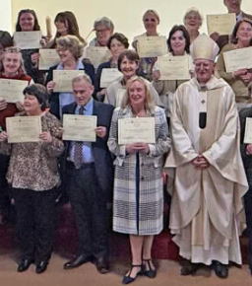
Our weekly exploration of St. Matthew’s Gospel continues each Monday at 7.30pm in the parish centre. The study centres around a video presentation, followed by an opportunity for questions and discussion. St. Matthew’s Gospel is the one that we are reading at Sunday Mass this year.
As part of the St. Finian’s Community College student leadership programme, Transition Year students are offering to meet parishioners to assist them with getting the most out of their devices (mobile phone, tablet, iPad etc). The students are offering this assistance under the supervision of their teacher in the parish centre. The first session took place on Friday following the 10.00am Mass. Please let the parish office know if you would be like to take part.
Many thanks to parishioners and visitors who have returned Easter Offerings. Easter offering envelopes are available on tables around the church.
Thanks, too, to parishioners who have handed in their Trocaire Lenten box. We ask that these be returned to the parish office or sacristy this Sunday 26th April! Many thanks for your generous contributions!
The family of the late Breege McGuinness would like to thank their friends and families who supported them through their sad time.
The Diocesan Office of Mission and Ministry are taking applications for both the Pathways and Catechesis courses for the coming year, which will start in September. A significant number of our parishioners have participated in these programmes over the past few years and found them very helpful in engaging in ministry in the parish. For more information, see the posters on our notice boards or on our website.
LEGION OF MARY:
Holy Mass for Anniversary of Venerable Edel Quinn 11am Saturday 9th May 2026 in St. Saviour’s Church, Dominick Street, Dublin 1
Religious Goods- Suitable for families
Confirmation and Holy Communion cards, prayer books, beads, medals and rosettes. Also Baptism cards and candles, motorist prayers, key rings, children’s books and lots more at repository Saturday evenings and Sunday mornings.
There are still some places available for our Partnership Pilgrimage to Rome and Assisi, which includes 2 nights in Assisi and 3 nights in Rome from 14-19th September. The pilgrimage is open to parishioners and friends from the parishes of Swords & Drynam, River Valley, Donabate and Brackenstown. The cost of €1,495 per person sharing includes return flights to Rome with Aer Lingus, half board accommodation in Rome and Assisi, air conditioned coach throughout the pilgrimage and assistance of a Marian Pilgrimages representative. For more details, look out for the posters and flyers. To reserve a place, parishioners are asked to book directly with Marian pilgrimages with a non-refundable deposit of €400 per person by Friday 1st May. Contact the parish office to get the link to book for the pilgrimage directly online.
Transition Year students from both Colaiste Choilm and St. Finian’s Community College will be taking part in an Action Day on Thursday next 29th April as part of the Laudato Si Awards project. Under the supervision of Paddy O’ Byrne, from our Care for Creation Committee, the students will help create a ‘hotel’ for insects and plant some seeds that will attract bees, thus facilitating pollination and bio-diversity.
Congratulations to John Punch (Funeral Ministry Team) and Sandra Hoey (Baptism Team), who have both just completed the Diocesan Certificate Course in Catechesis and were awarded their certificates by Archbishop Dermot at a ceremony last week!
PARISH PRIEST
Fr. Richard Sheehy
087 2412459
richardesheehy@gmail.com
PARISH CHAPLAIN
Fr. Joseph Hao P.C.
01 8401188
brackenstownparish@gmail.com
PERMANENT DEACON
Declan Colgan
01 8401188
brackenstownparish@gmail.com
PARISH SECRETARY
Louise Donnelly
Mon to Fri. 9:30am – 1:00pm
01 8401188
brackenstownparish@gmail.com
PARISH OFFICE HOURS
Monday - Friday
9:30am - 1:00pm
Registered Charity Number 20016166
PARISH PRIEST
Fr. Richard Sheehy
087 2412459
richardesheehy@gmail.com
PARISH CHAPLAIN
Fr. Joseph Hao P.C.
01 8401188
brackenstownparish@gmail.com
PERMANENT DEACON
Declan Colgan
01 8401188
brackenstownparish@gmail.com
PARISH SECRETARY
Louise Donnelly
Mon to Fri. 9:30am – 1:00pm
01 8401188
brackenstownparish@gmail.com
PARISH OFFICE HOURS
Monday - Friday
9:30am - 1:00pm
Registered Charity Number 20016166
SUNDAY MASS INTENTIONS
Recently Deceased
Jim Masterson
Christopher Mwosu
James Alexander
Month’s Mind
Caroline Hamilton
Anniversaries
Ian Corr (1A)
Darren Coleman (1A)
Margaret Green (1A)
Brian O’Toole (1A)
Molly Teeling (2A)
Brendan Carton (5A)
Pat Walsh (6A)
Mai Cunningham (22A)
Gemma Brosnan (27A)
Martina Harley (25A)
Anniversaries
Mary O’Neill
Noreen & Peter McKittrick
Muriel Harford
Susan Lennon
Rose Ann Connolly
Ann Dinan
Kay Savage
Frs Anselm & Oliver Kelleghan
James & Julia Kelleghan
Vincent, John & Nancy Kelleghan
Gerry & Betsy Nolan
Nancy Heron
Augustine Aissi
Eli Marcos
Paddy Ryan (BR)
Dcsd Members of O’Rourke
& Coates Families
10 AM MASSES
Mon | Joe McLoughlin (RD) Michael Pentony (Rem)
Tues | Pat McGonigle (RD)
Wed | Brendan O’Keeffe (A) Liam McDonald (BR)
Thur | Intentions of all who supported the family of the late Pat McGonigle
Fri | Jimmy Morris (RD) Special 90th Birthday Intention Christopher Mwosu (RD)
Sat | Madeleine Blacklock (RD)
THIS WEEK
Apologies for the mix up with last weekend’s Mass Intentions.

